Slide 1
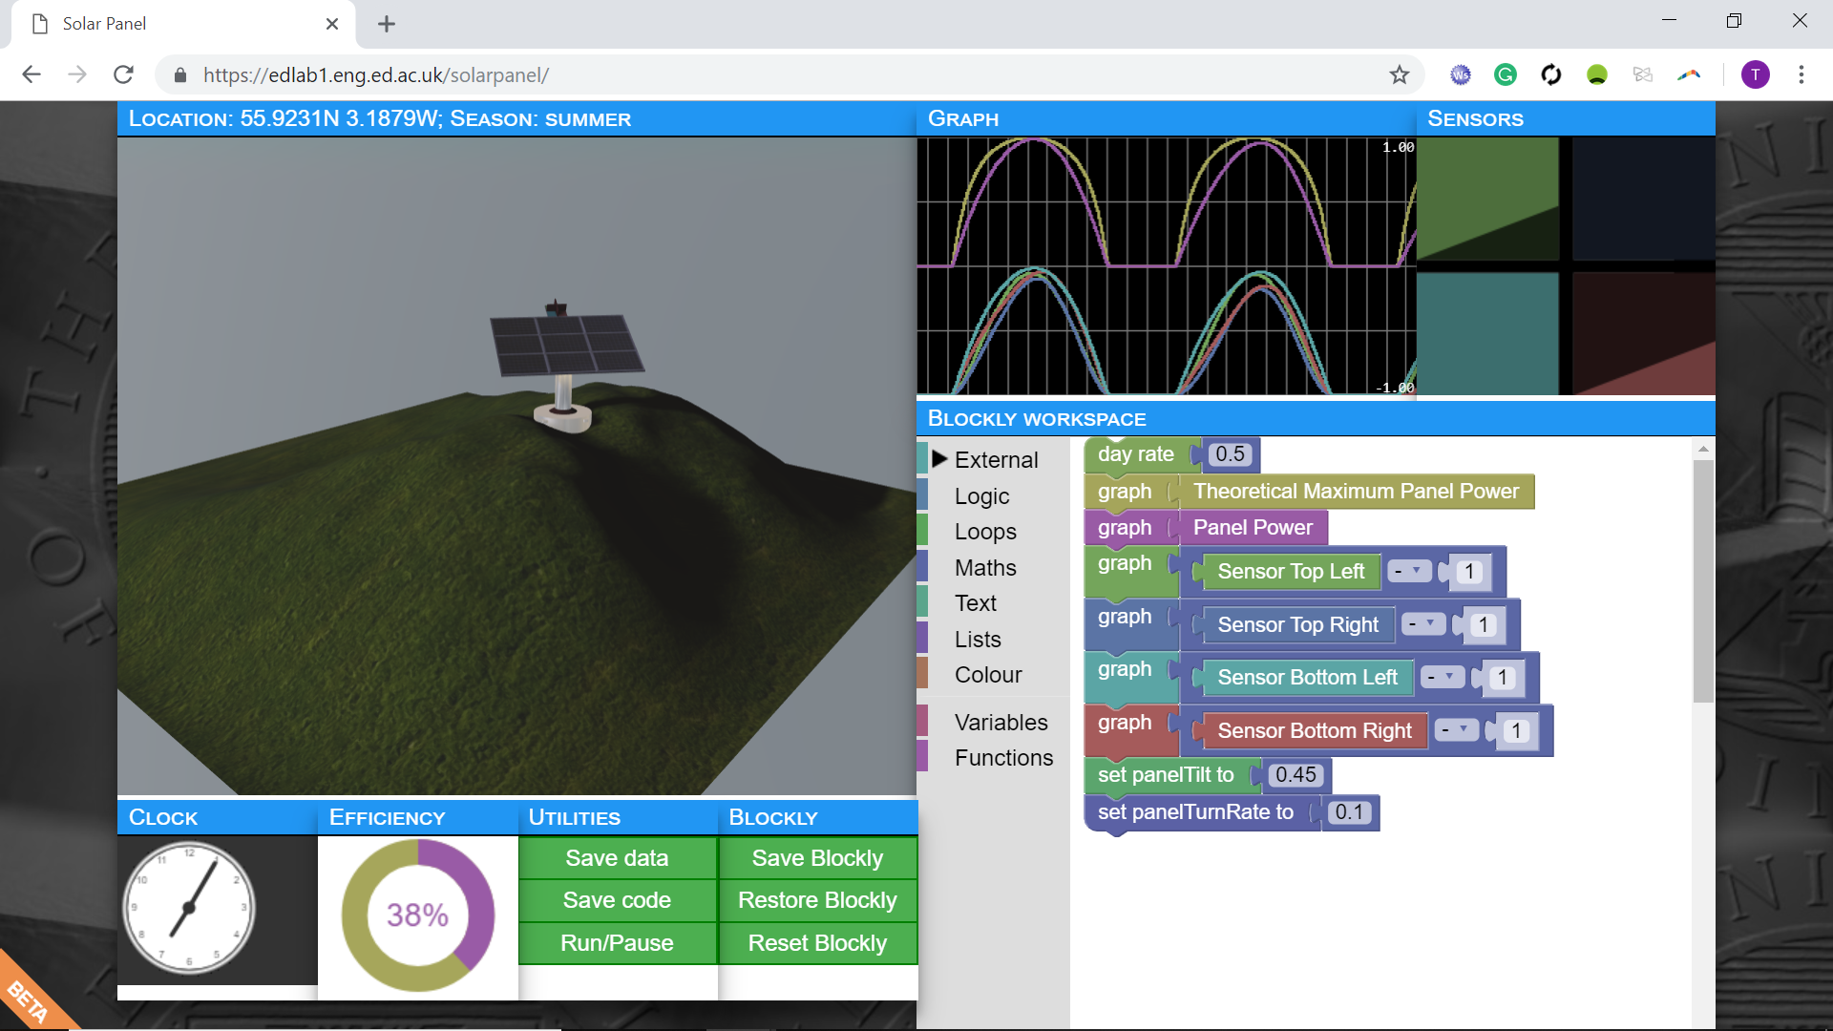
Performing engineering digital literacies in context
Prof Timothy D Drysdale, School of Engineering
Dr Jenny Scoles, Institute for Academic Development

Slide 2
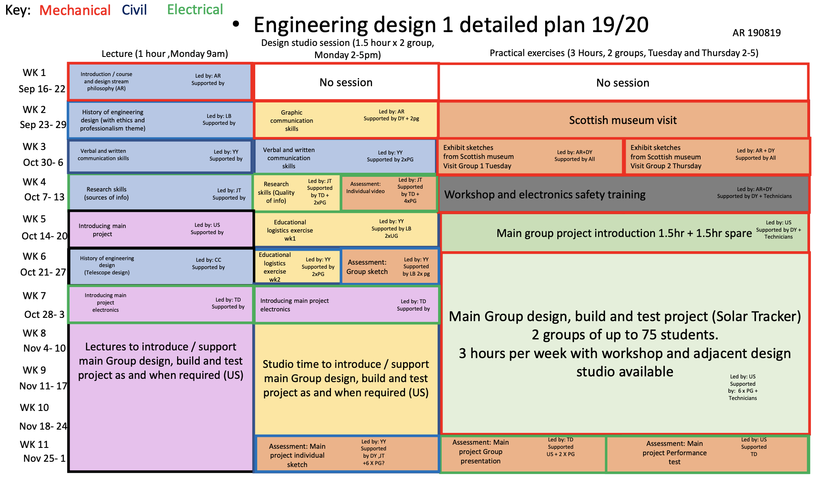
One hour on electronics ….
From zero to two-axis closed loop control
Robinson, U. Stein, T. Drysdale, C. Cunningham, et. al.

Slide 3
Problem solving difficulty
Open-ended (digital creation)
transition
Procedural (solving exam questions)

Slide 4
Iterative design is time consuming

Slide 5
Iterative design is time consuming

Slide 6
Assess on process not outcome?

Slide 7
Practical course constraints led to this:

Slide 8
Robinson, U. Stein, T. Drysdale, C. Cunningham, et. al.

Slide 9
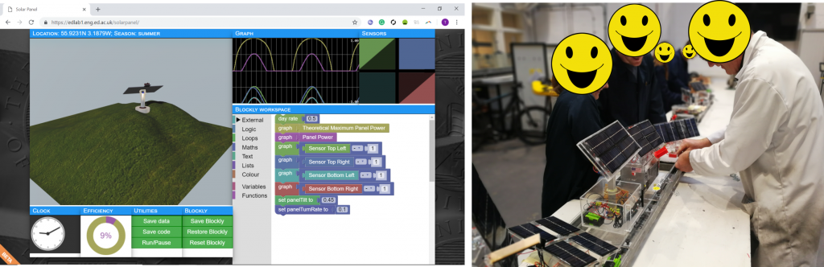
Final design: physical solar tracker

Slide 10
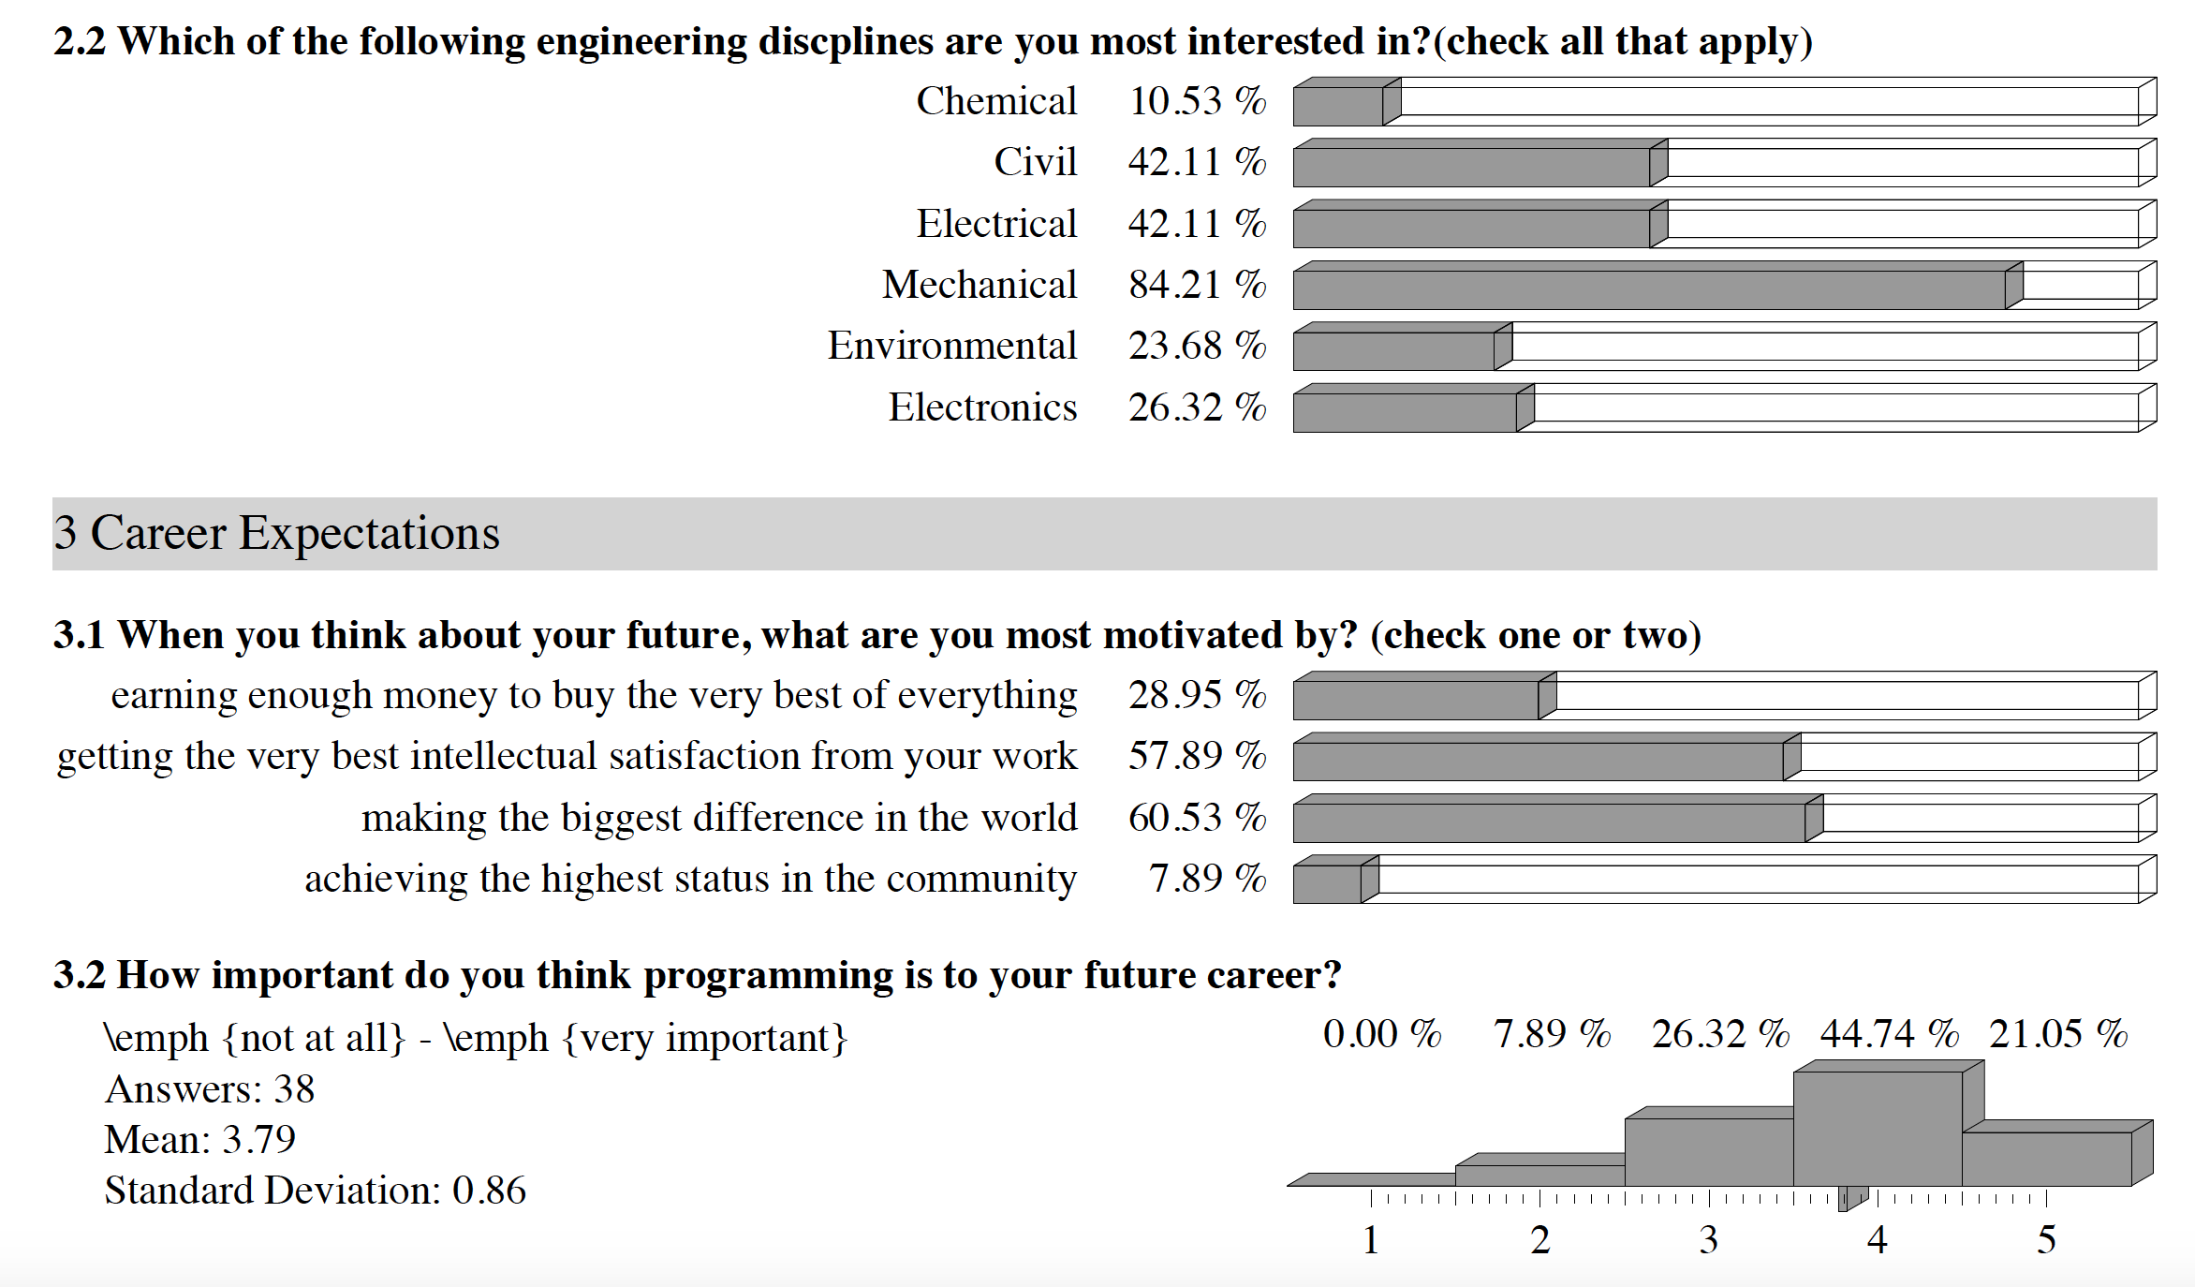

Slide 11
Final design: physical solar tracker
Anxiety gap

Slide 12
Add simulation intervention ….
Less anxiety?

Slide 13
Simulation
https://www.teaching-matters-blog.ed.ac.uk/learning-to-code-in-context/

Slide 14
Intervention
One hour lecture to introduce the design.
Followed by 90-minute tutorial: groups of 6-8 students at tables with a large monitor, and collaboratively programmed the simulation via the web-app.
No lab sheet, no formal collection of the final output, and no marks assigned.
Verbal guidance available in the room and intervention was designed to provide feedforward into the larger design activity.
Student surveys pre- and post activity showed reduced anxiety about design task complexity within the cohort.

Slide 15
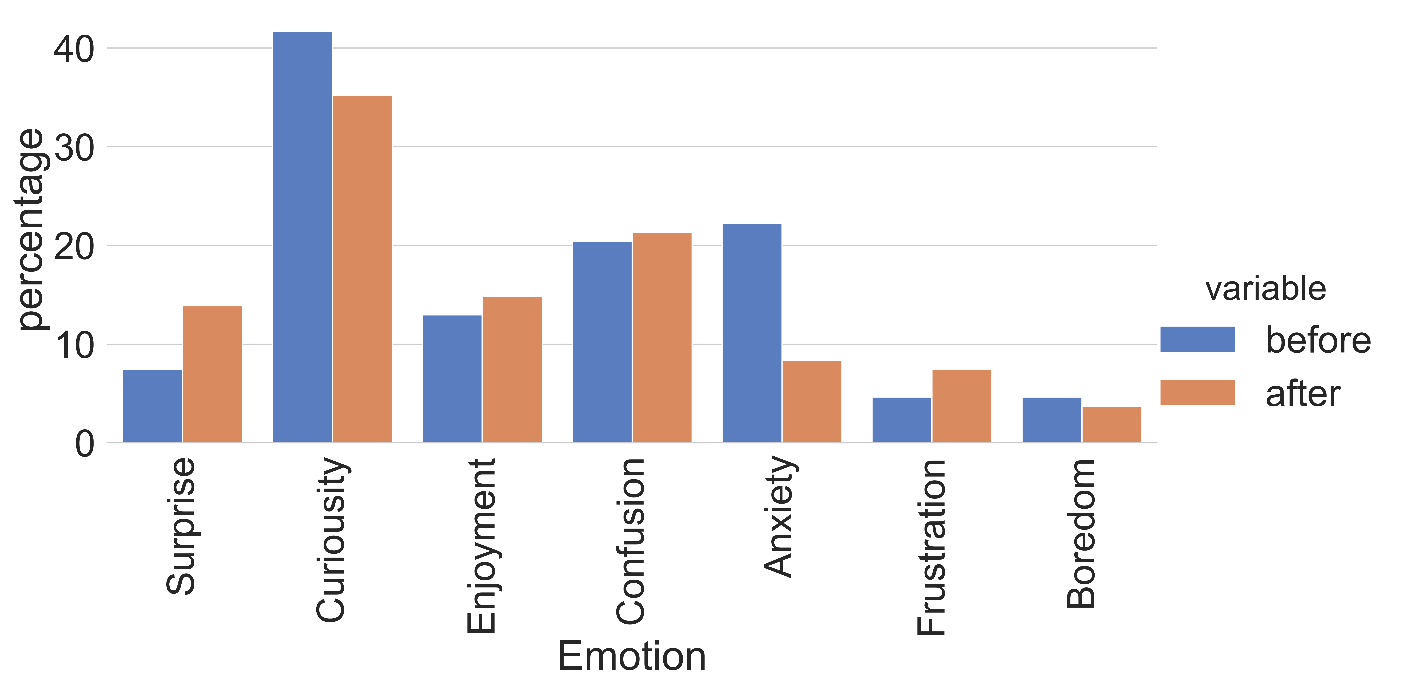

Slide 16
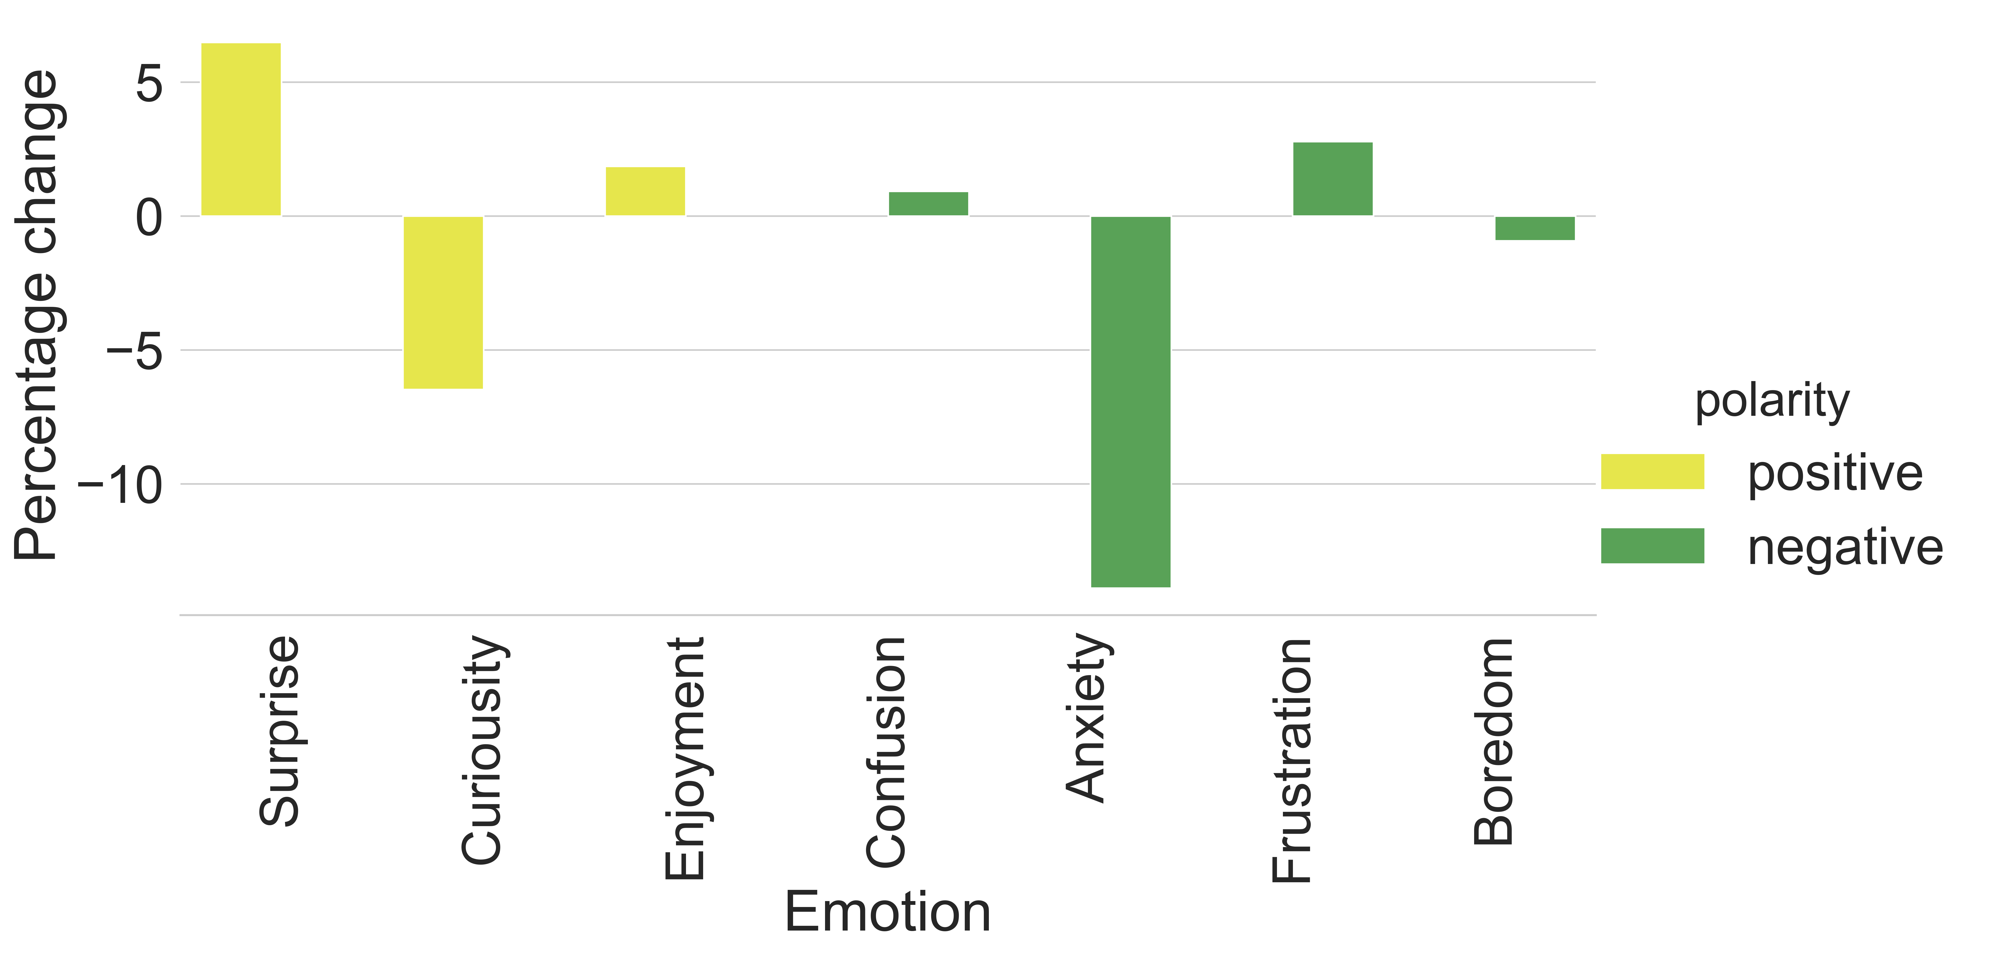

Slide 17
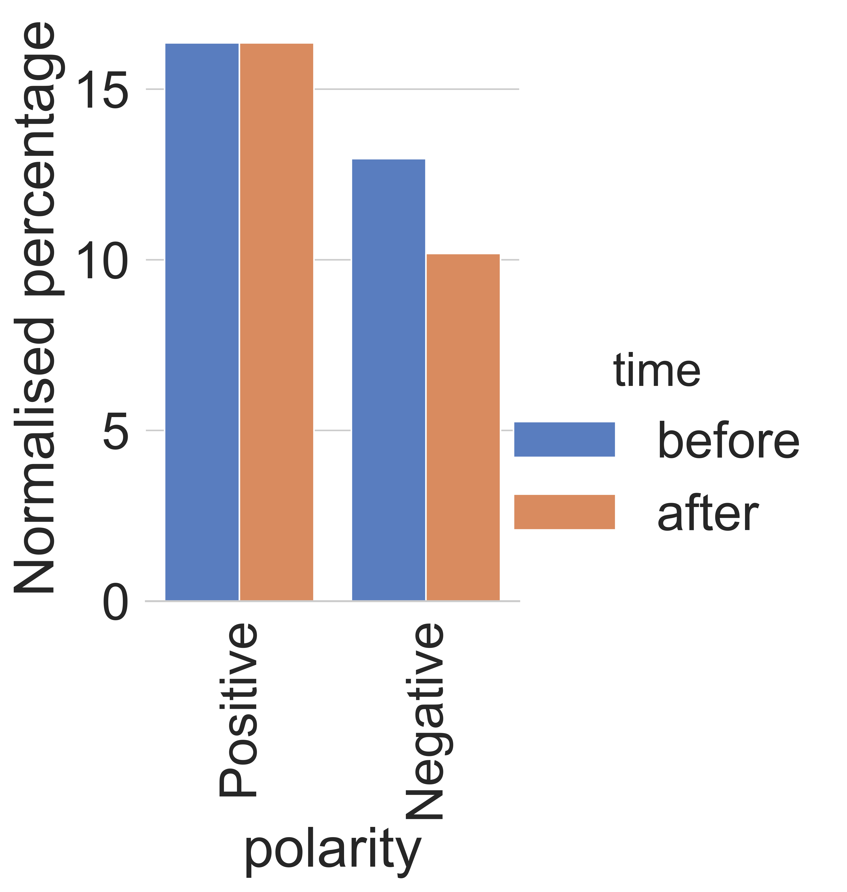

Slide 18
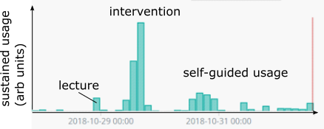

Slide 19
Two anecdotes struck us…
Broad range of engineering students feel programming is important skill to learn.
Students playing with the code the day after the activity.
Non-scheduled usage; ‘tinkering’ (Mol, 2010)
Where is room for playing and tinkering?
Where is the teacher?
One student’s output was very creative although very inefficient; Student pointed out that efficiency had not been specified as a criterion!
“The fate of what we say and make is in later users' hands”
(Latour, 1987: 29 )
- What does this mean for how we think about ‘digital skills’?

Slide 20
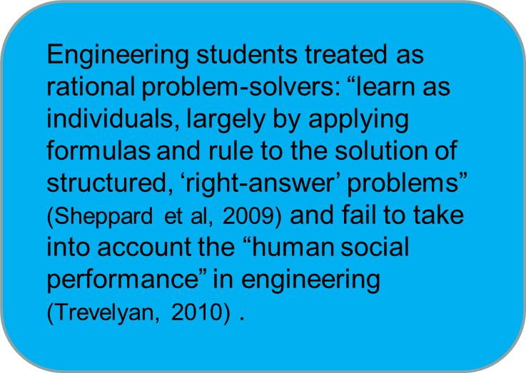
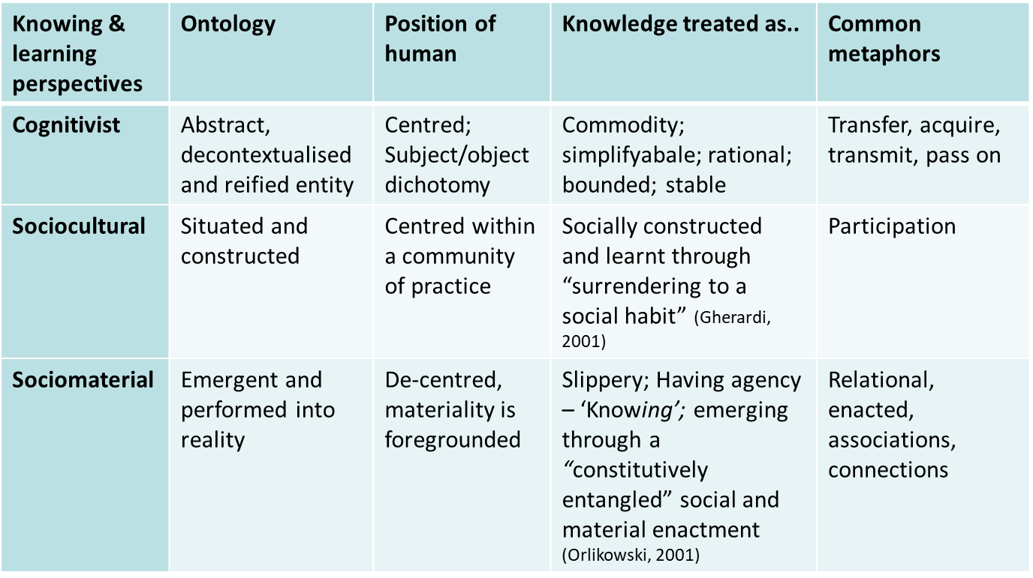
Metaphors

Slide 21
Sociomaterial approaches to knowing and learning….
Aim to de-centre the emphasis on the individual human subject.
Refute ‘knowledge’ as a static and abstract idea existing independently ‘out there’ to be acquired.
Metaphors of relationality, situatedness and emergence.
Knowledge and learning performed, or enacted, into reality, through relationships and connections with various artefacts – computers, teachers, webapps, observatory data sets, classroom spaces, timetables, rendering software.
Learning firmly situated in action, and emerges as a performance through different practices and processes: What do people do??
Humans not separated from nonhumans: What does this mean for more established educational theories that frame classroom as a ‘container’ for educational practices and learner as a separate, ‘free-floating’ individual (Fenwick, Edwards & Sawchuk, 2011).

Slide 22
Digital literacies as sociomaterial performances
Policy and research into digital literacies fail to show the ways in the social, cultural, and material dimensions are integral to how literacy practices are achieved and performed in work and learning.
Gourlay and Oliver (2016) argue that, in the translations of recent empirical work,
the nuanced nature of the data has been rendered less visible, which results in framing digital literacies as ‘quantifiable, relatively stable, generic and transferable entities’, which have been abstracted away from any specific, situated instance [and] whose defining features can be identified as residing in the individual.
Sociomaterial perspective: Digital literacies positioned as successful, co-constitutive social and technical achievements; more nuanced, messy and materially-mediated aspects of learning, and foreground the ‘specific, situated instances’.

Slide 23
Simulated labs as a sociomaterial learning experience?
Designing learning activities based solely on the concept of abstracted knowledge transfer and acquisition a focus on material affordances of the simulation and learning activity.
Students enter into learning spaces that invite tinkering, playfulness and surprise.
‘Right answers’ are not necessarily predetermined but can emerge through the material and social relations unfolding in the learning activity.

Slide 24
Can we explain what we saw by another conceptual framework?
A sociomaterial approach shapes our thinking for next reiteration.
Invites the non-human into the researchers’ gaze – ontologically and methodologically.
Postdigital: Technology not a support function (Bayne, 2015).
Helps answer questions about teacher in the room.
Survey questions: Ask people to say what they did
Ethnographic methods: Observe people and their relations with things/objects to see what they actually did in practice.
Notes:
Reason why this is a work in progress session is because we started asking ourselves different questions based on these two anecdotes.
So applying a post human lens applied to try to explain it in that context, so that we could shape our thinking for the next iteration of that
So can we explain what we saw through that different frame, even though not driven by that frame.
So that is why it becomes interesting in a post humanist sense because it will be used without the teacher in the room
What this acknowledgement of indirect relations does is shift the understanding of technology, away from tangible (and quite literally ‘to hand’) devices and gadgets, towards a view of entangled relationships, in which the digital is already embedded in what we might usually distinguish as the social, economic, and political. This represents an important frontier of understanding, particularly for education, for which the postdigital offers some useful insights.
MOOCs and other educational platforms are therefore better understood, not just as educational ‘tools’ or specific items of software, but as part of wider economic shifts that are restructuring education according to the promise of data, and the habitual claims of precision and efficiency which accompany them.

Slide 25
Summary
Re-running the intervention
Evolve survey
Add ethnographic observation
Improve simulation (loops)
Add new features (results board)

Slide 26
References
ammienoot.com/brain-fluff/why-we-need-learning-technology-developers/
Bayne, S. (2015). What’s the matter with ‘technology-enhanced learning’? Learning, Media and Technology, 40(1), 5–20.
Knox, J. (2019). What Does the ‘Postdigital’ Mean for Education? Three Critical Perspectives on the Digital, with Implications for Educational Research and Practice. Postdigital Science and Education
Mol, A. (2010). Actor-Network Theory: sensitive terms and enduring tensions. Kölner Zeitschrift für Soziologie und Sozialpsychologie. Sonderheft, 50, 253-269.
Latour, B. (1987) Science in Action. Harvard University Press.
Latour, B. (2004). Why has critique run out of steam? From matters of fact to matters of concern. Critical Inquiry, 30(2), 225–248.
Orlikowski, W. J. (2007). Sociomaterial practices: Exploring technology at work. Organization Studies, 28(9), 1435–1448.
Walker, J.M. (2018). The future of education is open source. Accessed: https://open.edx.org/blog/future-education-open-source
www.teaching-matters-blog.ed.ac.uk/learning-to-code-in-context/

Slide 27
EXTRA SLIDES

Slide 28
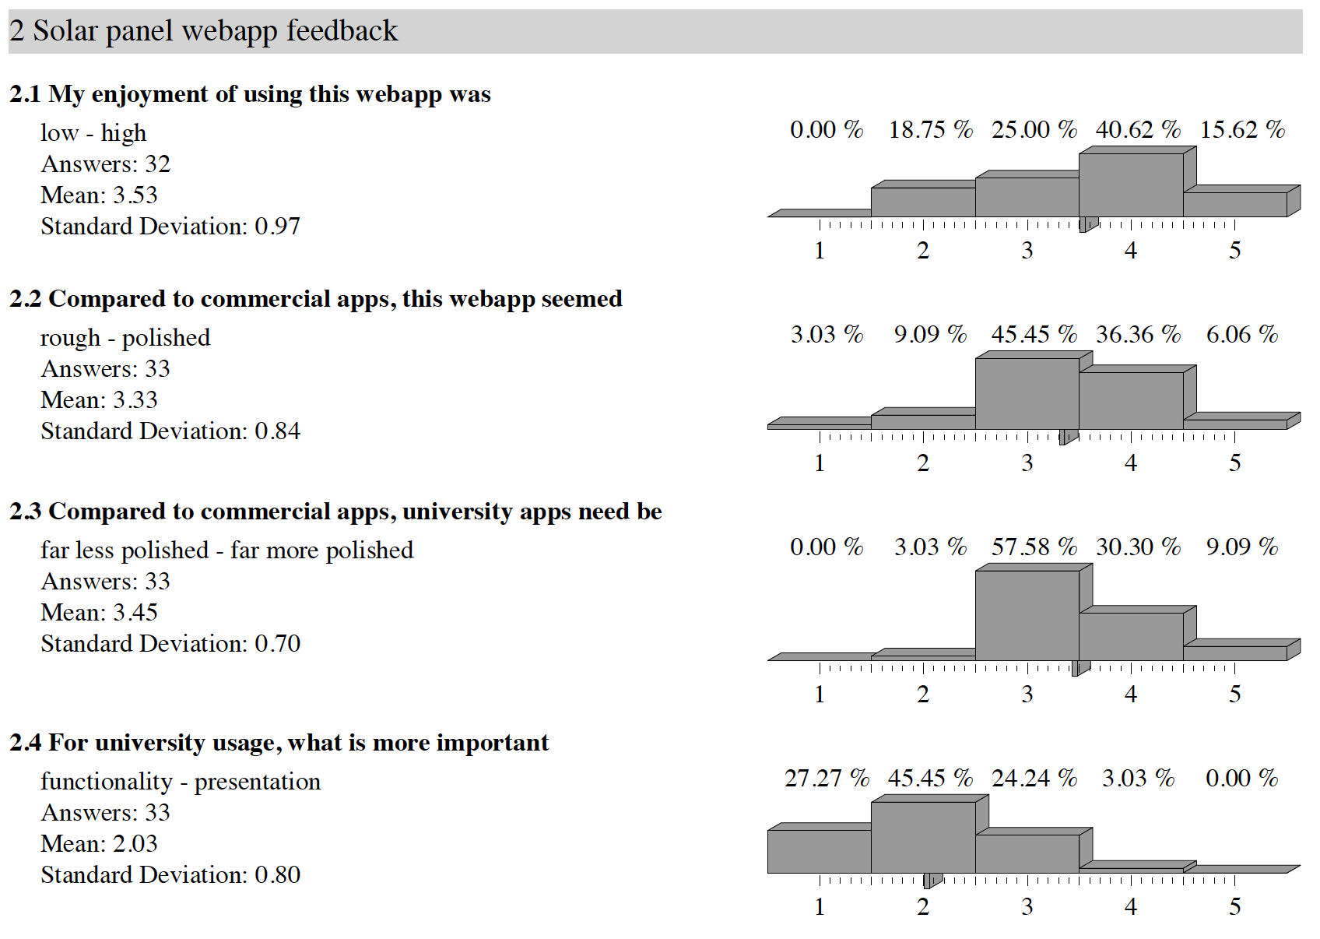

Slide 29
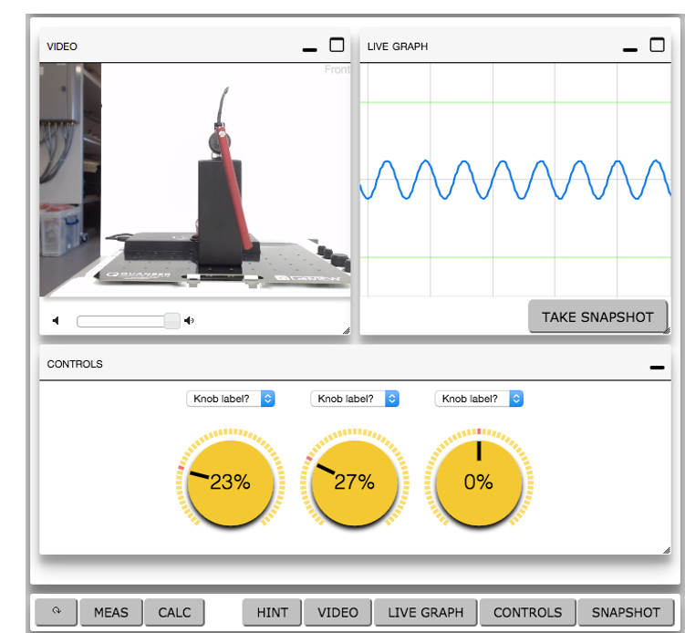
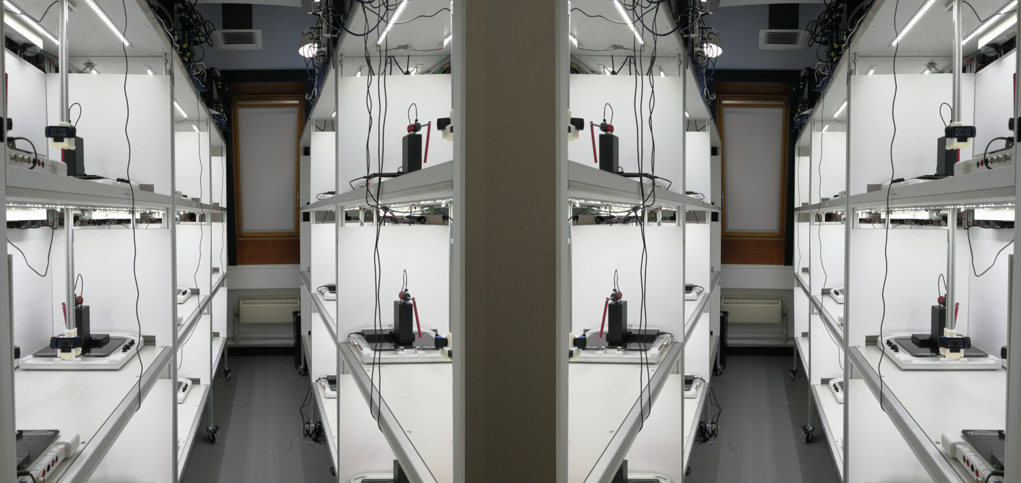
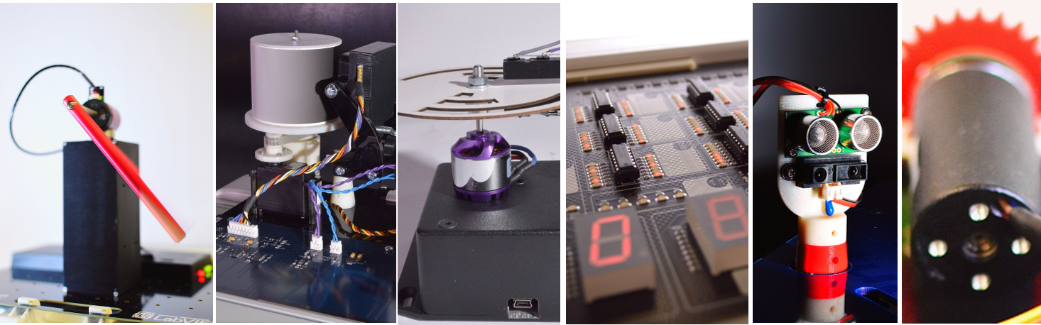
Remote labs example
openEngineering Lab @ The Open University
Notes:
Remote labs as a non traditional practical work option, he was founding director and lead developer of the open engineering lab at Open University
The equipment is locked in room, its distance learners. When

Slide 30
www.teaching-matters-blog.ed.ac.uk/learning-to-code-in-context/

